Slide 1

Testing and Verification (CSC7056/CSC3056)
Aidan McGowan
What is Testing ?
Seven Principles of Testing
Psychology of Testing

Slide 2



What does Testing involve ? An exercise…
Searching
As a user, I want to be able to use a mobile device to be able to conduct a web search and find information on Pink Floyd’s The Wall and The Dark Side of the Moon.

Slide 3

What does Testing involve ? An exercise…
What are you going to test (Test Conditions) ?
How are you going to test (people, devices involved , schedule etc. )?
Test cases (more detailed than Test Conditions)?
Execution of tests?
Results?
Progress reporting?
How do you know you are finished testing?
Who do you report to ? What do you report ?

Slide 4
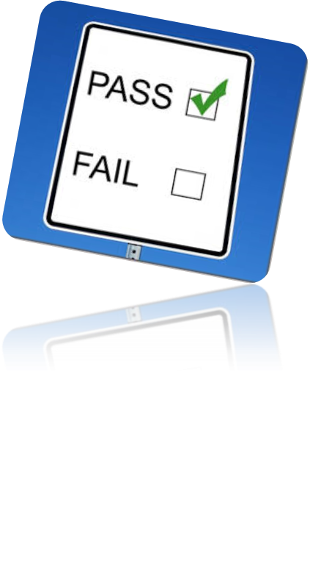
Ad hoc procedure
Team of three
Pick a Test Lead
Create a Plan – schedule, list activities (resource)
From Test Basis .. Create Test Conditions (What you are going to test) … Test Cases & Procedures (How you are going to do it)
Execute the tests
Record results
Report.
Close

Slide 5
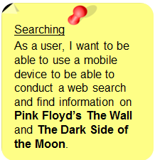
Test Basis to Test Cases
Test Basis
Test Conditions ..
  Test that it is possible to search via a mobile device for information on The Wall (Pink Floyd) etc.
  “To Show that…”
Test Cases (input data, expected results)
  Input Expected
  1.“Pink Floyd The Wall” List of web sites
  2.“Wall Pink Floyd” List of web sites
Test Procedure - The script containing the test steps
For test case 1 :
      Open browser app
      Go to search engine
      Input in search Criteria

Slide 6

What does testing involve ?
More than just running Tests
Planning and Control
Choosing test conditions
Designing and executing test cases
Checking results
Evaluating exit criteria
Reporting test progress
Reviewing documents
Conducting static analysis
And much more . . . . . . .
Notes:
Test basis : All documents from which the requirements of a component or system can be
inferred. The documentation on which the test cases are based. If a document can be
amended only by way of formal amendment procedure, then the test basis is called a frozen
test basis.
test condition: An item or event of a component or system that could be verified by one or more test cases, e.g. a function, transaction, feature, quality attribute, or structural element.
test case: A set of input values, execution preconditions, expected results and execution postconditions, developed for a particular objective or test condition, such as to exercise a particular program path or to verify compliance with a specific requirement.

Slide 7

Fundamental Test Process
Five Main Activities
Test Planning and Control
Test Analysis and Design
Test Implementation and Execution.
Evaluating Exit Criteria and Reporting
Test Closure

Slide 8

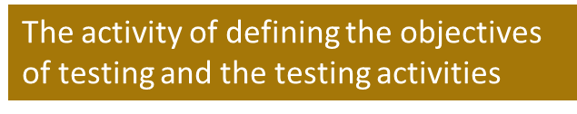

Fundamental Test Process
1. Test Planning and Control
The on-going activity of comparing progress against the plan and reporting status

Slide 9

Fundamental Test Process
2. Test Analysis and Design
Reviewing the test basis
Evaluating the testability of the test basis
Identifying and prioritising test conditions
Designing and prioritising high level test cases
Identifying necessary test data
Designing the test environment set-up
Identifying any required infrastructure and tools
Creating bi-directional traceability
  Test cases to test basis
  Test basis to test cases

Slide 10

Fundamental Test Process
3. Test Implementation and Execution
Finalising and prioritising test cases
Finalising the test data
Developing and prioritising test procedures
Creating the test data
Preparing test harnesses
Writing automated test scripts
Creating test suites from the test procedures for efficiency

Slide 11
Fundamental Test Process
3. Test Implementation and Execution (Cont.)
Verifying the test environment has been set up correctly
Verifying traceability between test basis and test cases
Executing test procedures in planned sequence
  Manually or using test execution tools
Logging the outcome of test execution
Comparing actual results with expected results
Recording discrepancies as incidents
Analysing incidents for causes
Repeating test activities (with any necessary regression)

Slide 12
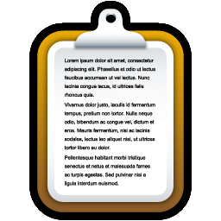
Fundamental Test Process
4. Evaluating Exit Criteria and Reporting
Checking logs against exit criteria specified in Test Planning
Assessing if more tests are required
Assessing if exit criteria need changing
Writing a test summary for stakeholders

Slide 13

Fundamental Test Process
5. Test Closure
Checking planned deliverables have been delivered
Closing incident reports
Raising change records for remaining open incidents
Documenting the acceptance of the system
Finalising and archiving test-ware and test environment
Analysing lessons learned
Using information gathered to improve test maturity (retrospective)

Slide 14
Fundamental Test Process
Possible Iterations
Test Planning and Control
Test Analysis and Design
Test Implementation and Execution
Evaluating exit criteria and reporting
Test Closure

Slide 15
The Seven Principles of Testing
Testing shows the presence of defects
Testing can show the defects are present, but cannot prove that there are no defects. Even after testing the application or product thoroughly we cannot say that the product is 100% defect free.
Testing always reduces the number of undiscovered defects remaining in the software but even if no defects are found, it is not a proof of correctness.

Slide 16
The Seven Principles of Testing
Exhaustive testing is impossible
Testing everything including all combinations of inputs and preconditions is not possible. So, instead of doing exhaustive testing we can use risks and priorities to focus testing efforts.
For example: In an application in one screen there are 15 input fields, each having 5 possible values, then to test all the valid combinations you would need 30,517,578,125 (5¹⁵) tests. This is very unlikely that the project timescales would allow for this number of tests. So, accessing and managing risk is one of the most important activities and reason for testing in any project.

Slide 17
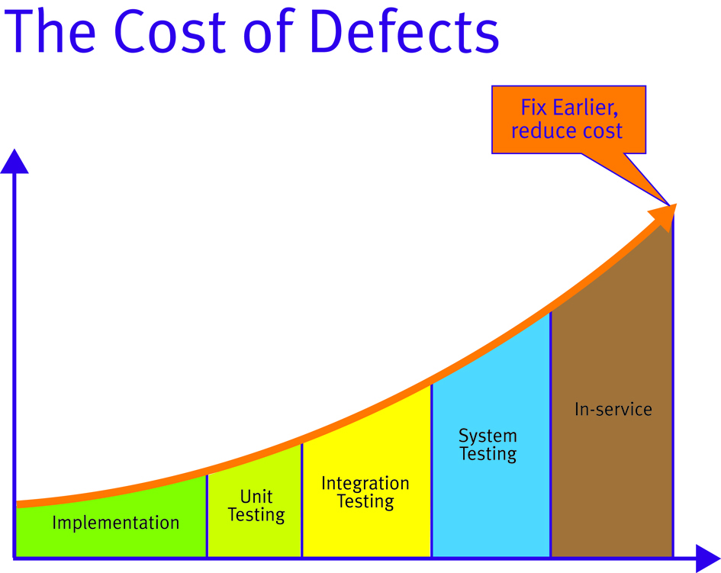
The Seven Principles of Testing
Early testing
In the software development life cycle testing activities should start as early as possible and should be focused on defined objectives.

Slide 18

The Seven Principles of Testing
Defect Clustering
A small number of modules contains most of the defects discovered during pre-release testing or shows the most operational failures.
Notes:
The Pareto principle (also known as the 80–20 rule, the law of the vital few, and the principle of factor sparsity) states that, for many events, roughly 80% of the effects come from 20% of the causes.
80% of your sales come from 20% of your clients
1906 that 80% of the land in Italy was owned by 20% of the population

Slide 19
The Seven Principles of Testing
Pesticide paradox
If the same kinds of tests are repeated again and again, eventually the same set of test cases will no longer be able to find any new bugs. To overcome this “Pesticide Paradox”, it is really very important to review the test cases regularly and new and different tests need to be written to exercise different parts of the software or system to potentially find more defects.

Slide 20


The Seven Principles of Testing
Testing is context dependent
Testing is basically context dependent. Different kinds of sites are tested differently. For example, safety – critical software is tested differently from a free mobile app.

Slide 21

The Seven Principles of Testing
Absence-of-errors fallacy
If the system built is unusable and does not fulfil the user’s needs and expectations then finding and fixing defects does not help.

Slide 22
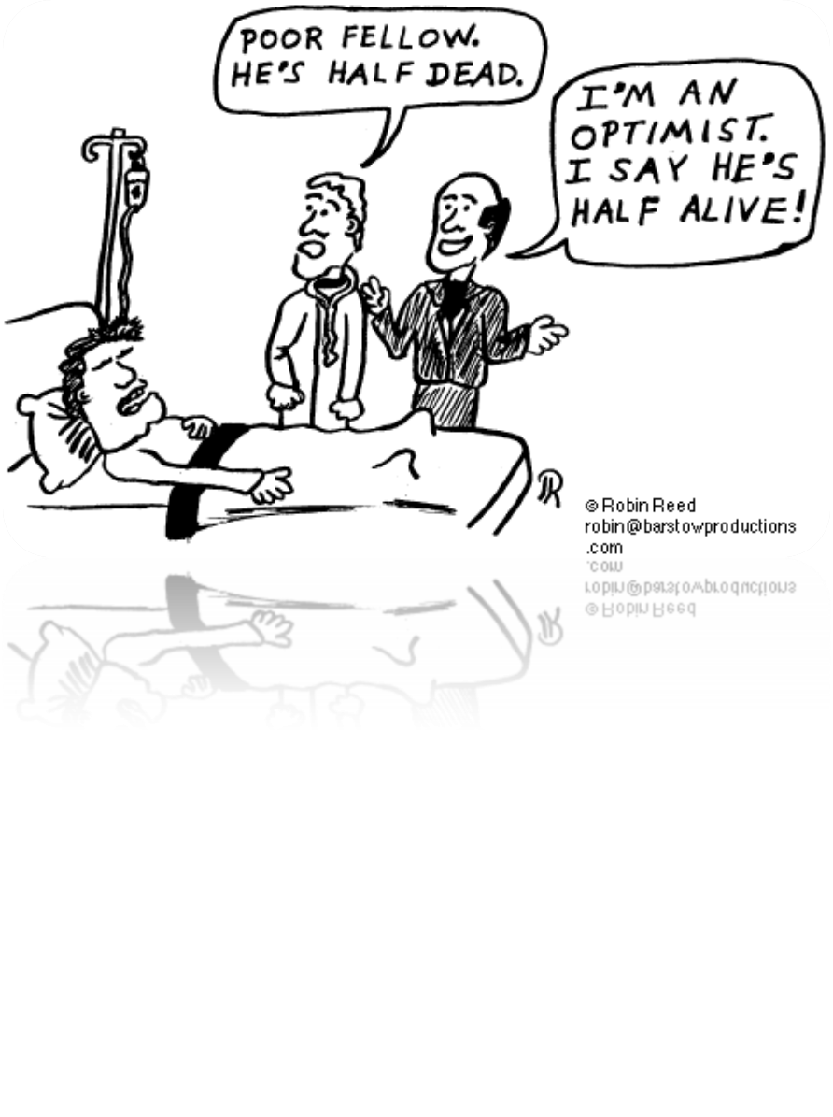
Psychology of Testing

Slide 23


Psychology of Testing
Typical Mind-sets
The software is of acceptable quality
It will work
Tend to look for what works
Thinks testers are too negative and pedantic
The software contains defects
It won’t work
Tend to look for what does not work
Thinks developers are too optimistic
Developer
Tester

Slide 24
Psychology of Testing
Levels of Independence
Tests Designed by
The person(s) who wrote the software
Another person(s) from the development team
A person(s) from a different group
  Independent test team
  Test specialists
A person(s) from a different organisation or company
least
most

Slide 25
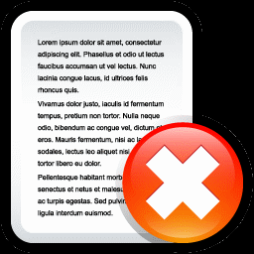
Psychology of Testing
Views of Failures Found
Tester
A job well done
Time and money saved
Reduced risk
Developer
Criticism of their work
Criticism of themselves

Slide 26
Psychology of Testing
Possible Approach
Promote collaboration not battles
Remind all of common goal
Communicate failures found in a neutral fact-focused way
Do not criticise the author
Understand how the other person feels
Try to understand why they react the way they do
Confirm the other person understands what you have said and vice-versa

Slide 27

Psychology of Testing
What makes a good Tester?
Curiosity
Professional pessimism
A critical eye
Attention to detail
Good communicator
Experience on which to base error guessing

